Slide 1

TEAM
DATA WIZ
FOR WASHINGTON DIGITAL NEWSPAPERS
Aayushi Gandhi, Manthan Mehta, Harshi Thaker
SUNDAY ● JUNE 4 ● 2023
WASHINGTON STATE LIBRARY
EDITION Nº 001

Slide 2
EXECUTIVE SUMMARY
Overview.
The Washington Digital Newspapers (WDN) is an online archive of historically significant newspapers that can be used to produce data visualizations, apps for mobile devices, educational materials, or other data presentation techniques. In our capstone project, Team Data Wiz has created an interactive data visualization for the Washington State Library for the purpose of visualizing this archive in a more cohesive format. This in turn aids in answering any questions users might have about the archive.
Purpose.
The Washington State Library came to Team Data Wiz to find a way to better analyze their online archive of historically significant newspapers.
The Washington Digital Newspaper program has a repository of over 600,000 newspapers that are digitized over time (1852-2021). However, not all of this is stored in a single place for them to use for deriving insights. Team Data Wiz was tasked with creating a single dataset of the record of newspapers, including additional informative details about publication county, dates and number of issues to help perform data analysis on the same.
Objectives.
The main goal of our project is to lend structure to raw data in order to ultimately be able to help users at Washington State Library answer questions that would enable them to derive insights from the historic data.
In order to meet our project objectives, we followed a rigorous process of collaboration with our primary stakeholders, additional background research, data extraction, data wrangling and transformation. In doing so, Team Data Wiz, in consensus with our stakeholder at Washington State Library, reached upon a conclusion that an interactive data visualization is the best solution.
Result and Impact.
In our final deliverable, we have curated an interactive dashboard that consists of data visualizations that will answer all the logistic questions that users at Washington State Library have about the online archive of newspapers.
The strongest impact our solution has is shifting the tedious process into something that is streamlined and efficient. Moreover, it provides one single place where all the information about any digitized newspaper can be found, unlike their current state, which does not include the entire data set.
SUNDAY ● JUNE 4 ● 2023
WASHINGTON STATE LIBRARY
EDITION Nº 001

Slide 3

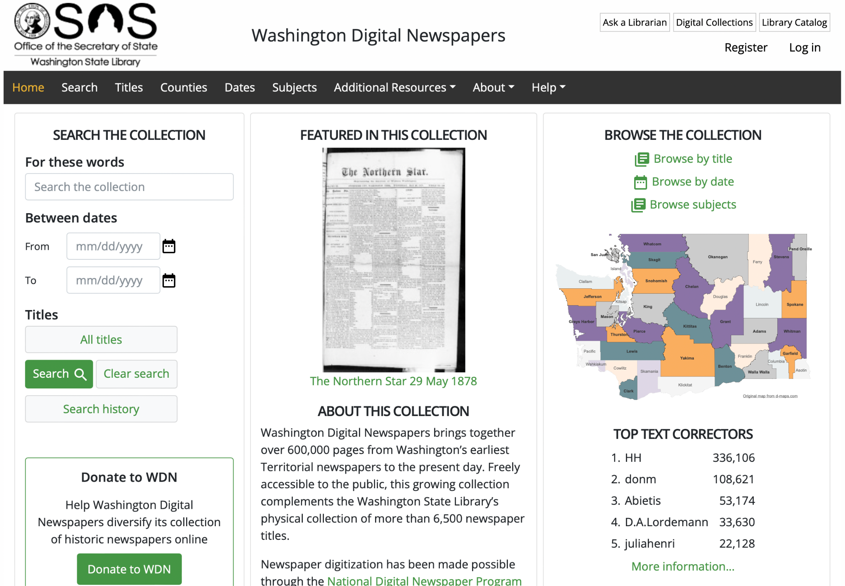
ORGANIZATION OVERVIEW
Washington Digital Newspapers.
Washington State Library houses a vast collection of digitized materials, including historical documents, photographs, newspapers, maps, and audiovisual materials. These collections are accessible online, providing valuable resources for researchers and the public.
The Washington Digital Newspaper Program is an initiative undertaken by the Washington State Library to digitize and provide online access to historical newspapers from Washington State. The program aims to preserve and make available these valuable resources for researchers, historians, genealogists, and the general public.
Our Capstone project falls under the jurisdiction of the WDN program.
Stakeholders.
Shawn Schollmeyer, Washington Digital Newspapers Coordinator.
Shawn has been our primary stakeholder for the Capstone project.
Summary and Background.
The Washington State Library is a government agency located in Tumwater, Washington, and serves as the library for state government and the reference library for all Washington residents. It is a part of the Office of the Secretary of State in Washington State.
The Washington State Library aims to provide access to information and resources for government agencies, state employees, and the general public. Its primary focus is to support the research, educational, and information needs of state government and libraries across Washington.
SUNDAY ● JUNE 4 ● 2023
WASHINGTON STATE LIBRARY
EDITION Nº 001

Slide 4
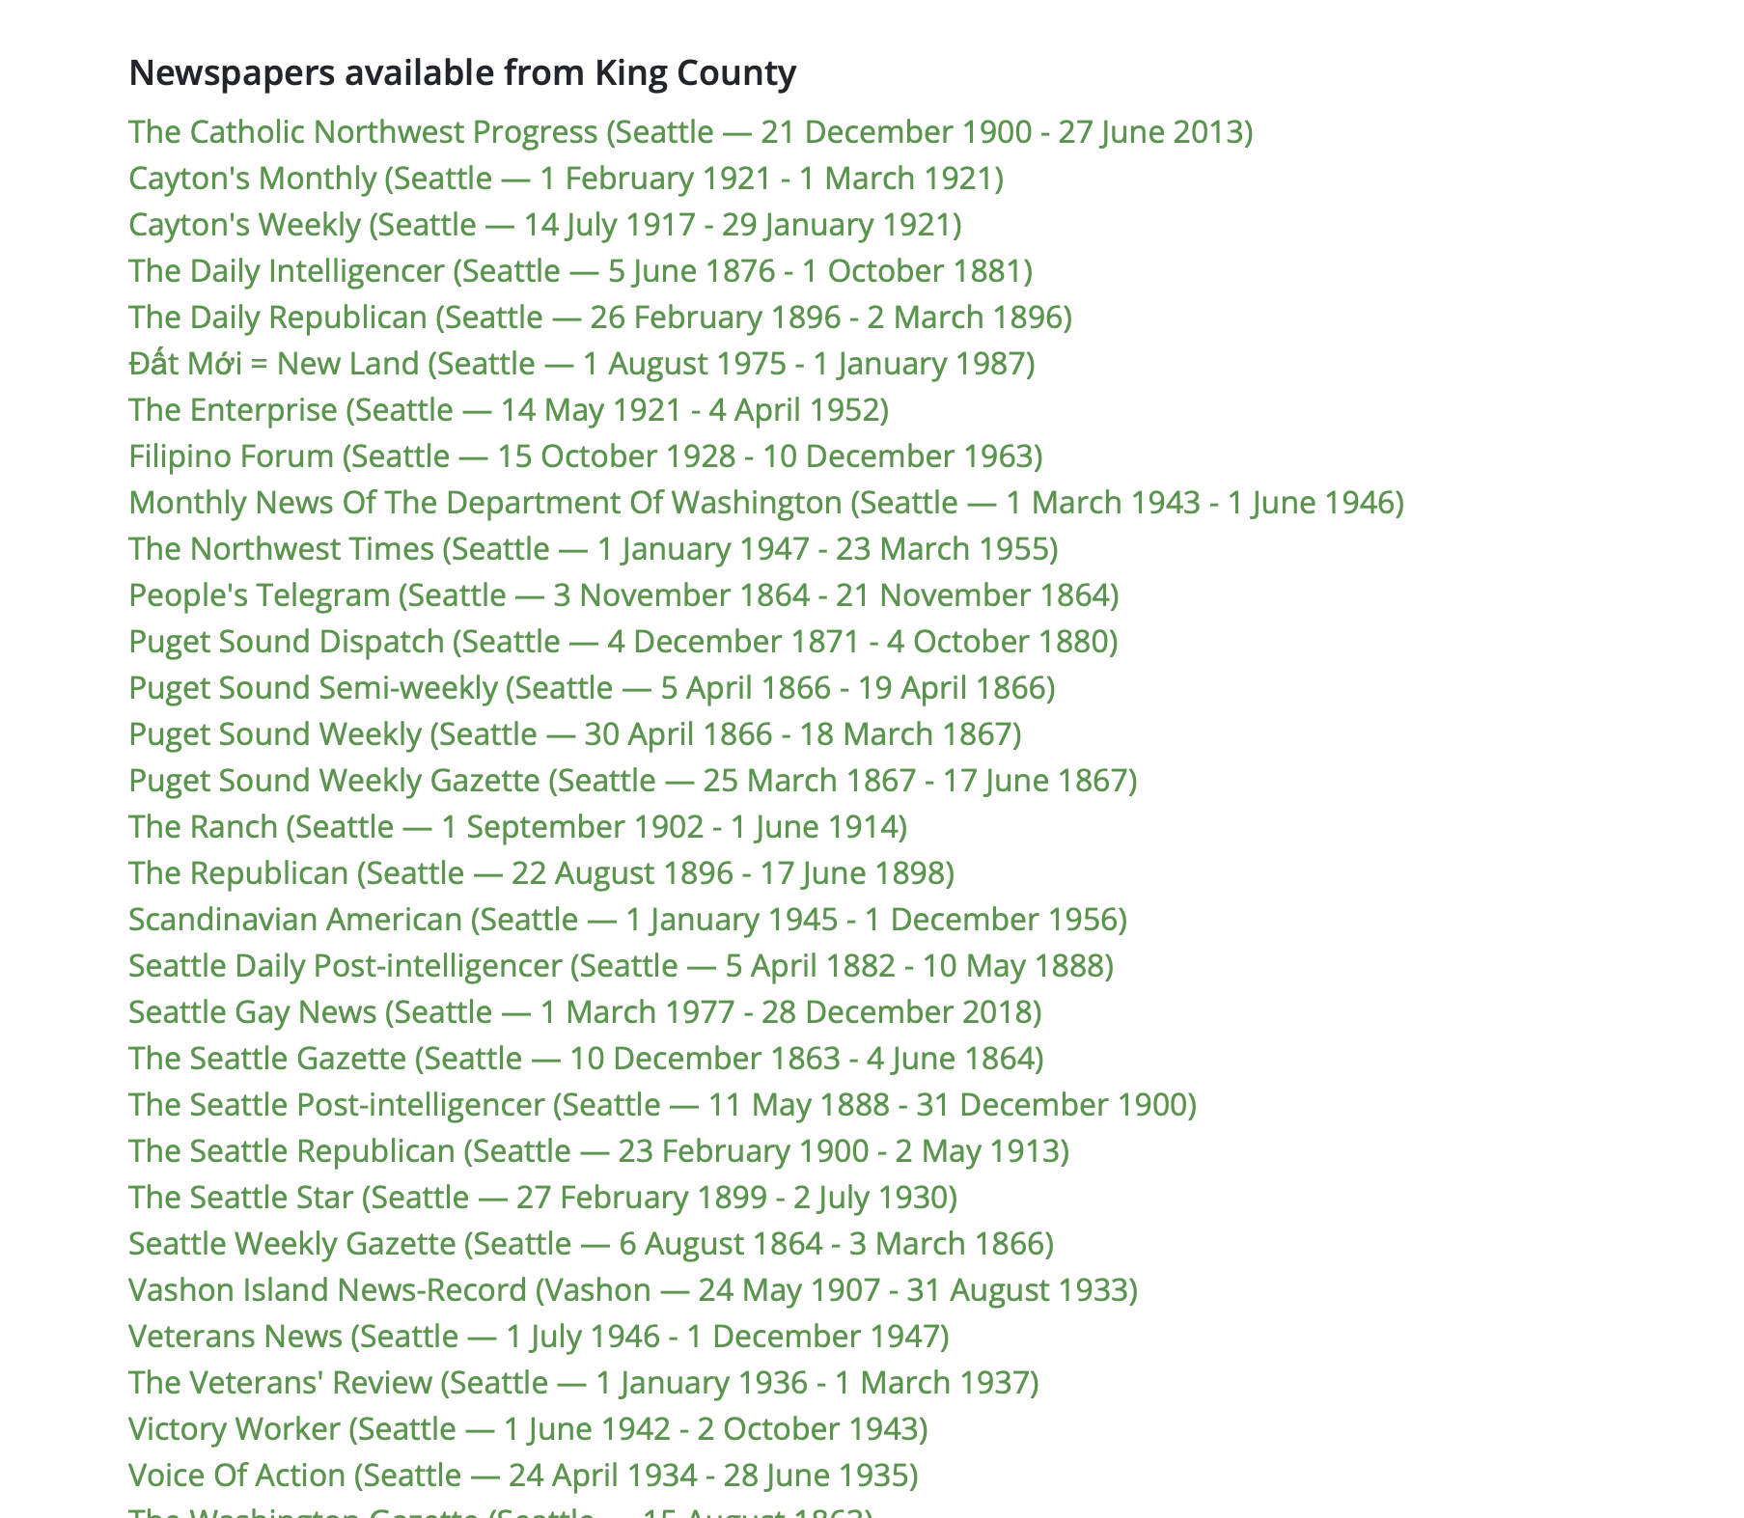
ISSUES AND OPPORTUNITIES
Issues.
The current state of the WDN program is as depicted in the image alongside - the data is unstructured. This brings up the problem of overlooking important information. There may also be a scenario where it can get difficult to completely understand where the gaps lie in the current data that is available for analysis. This again leads to poor data analysis and derivation of insights from the data.
Opportunities.
Our list of issues presents us with opportunities to work with. We came up with a list of things we want improve for by means of our Capstone project. Firstly, we made a brand new dataset by pulling data from multiple sources to establish one source of truth. Secondly, we used Tableau to create interactive dashboards that lended structure to the data available. Thirdly, we published this onto Tableau Public which gives our work visibility not just within the state of Washington, bust also all around the globe. Lastly, we coached our primary stakeholder on the maintenance of the interactive dashboards enabling them to keep updating it as and when they are presented with new data.
SUNDAY ● JUNE 4 ● 2023
WASHINGTON STATE LIBRARY
EDITION Nº 001

Slide 5
APPROACH
1 - Project Schedule plan
FALL’ 22
WINTER’ 23
SPRING’ 23
The project was approached in a structured manner with a major focus on solving for the right problem using an optimized project management and agile approach.
A schedule along with Key performance indicators (KPI) was set up during initial stakeholder discussions to ensure there were defined deliverables, deadlines, action items and regular check-ins and project updates.
This ensured the project was on track, adhere to the deadlines, escalate issues and eliminate any unforeseen challenges
Stakeholder Interactions
Solution Ideation
Requirements Gathering
Dataset development & transformation
Design & Implementation
Handover
SUNDAY ● JUNE 4 ● 2023
WASHINGTON STATE LIBRARY
EDITION Nº 001

Slide 6
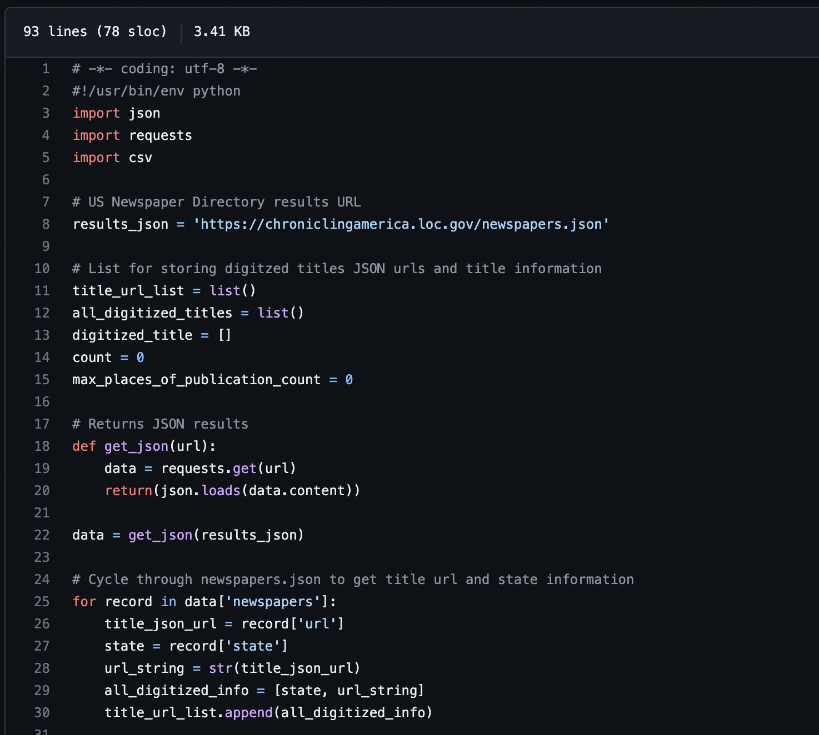
APPROACH
2 - Data Extraction
In order to cater the needs and requirements of the stakeholder, i.e. perform data analysis, we need to first get ahold of the data available.
All data related to the digitized newspapers was made available to the public via the Chronicling America website and one could navigate the website to find information related to any newspaper that was digitized.
The issue was that Washington state library did not have a well-defined or structured database as it was storing all the information regarding the digitized newspapers on the Chronicling America Website. Hence, the first step in this process was to extract all the data available on the website and store it in a place where it can be cleaned & transformed for further analysis.
Data Extraction using Python
To extract the data from the Chronicling America website, we developed a Python script that interacts with the Chronicling America API to collect basic metadata about all available digitized newspapers into a csv file. The metadata retrieved in this step includes the newspaper names, publication locations, dates, and quantities of digitized issues available in the system.
Python's simplicity, powerful libraries, extensive community support, and flexibility made it an excellent choice for web scraping.
Additional data was brought in from a third-party vendor directly in json format and specific data was extracted, resulting in a comprehensive data set.
SUNDAY ● JUNE 4 ● 2023
WASHINGTON STATE LIBRARY
EDITION Nº 001

Slide 7
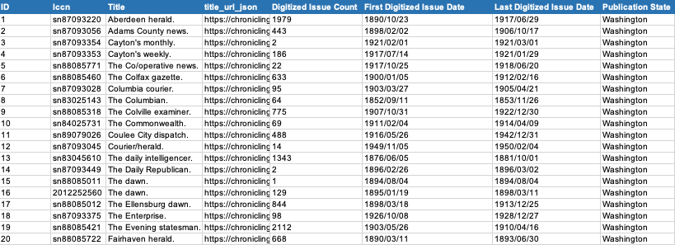
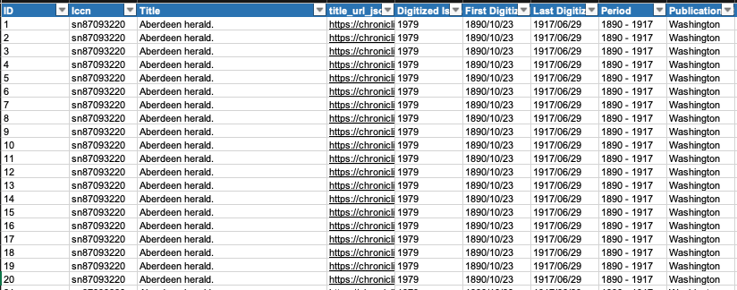
APPROACH
3 - Data Wrangling & Transformation
The raw data was collected and accumulated into a csv file. Based on the Stakeholder discussions, the resulting analysis was to be done based in data specific to the counties in the Washington State. Taking this into consideration, and also the fact that the resulting data set was small about 113 records, we decided to use Excel for data wrangling and transformation purposes.
Data Wrangling using Excel
The data captured from the website was unstructured and not fit for analysis. Some Data Wrangling was performed to make the data consistent and structured.
Dates were formatted into a yy/mm/dd format
Unnecessary columns from the dataset were eliminated/removed
Original Scraped data set (113 rows)
New columns such as ID, Period, Issued Date, subject & language were included
Additional Data Acquisition from JSON files
The summarized data set consisted of around 113 records with 113 different newspaper titles in Washington State. However, to provide a time series analysis, the data needed to be drilled down for each newspaper title with specific information about all the dates when the newspaper was available. This data was manually extracted using the json urls extracted from the website resulting in an enhanced data set of 84k rows
An online tool was used to convert the json urls into csv files and then the digitized dates columns were created.
Drilled Down data set (84k rows)
SUNDAY ● JUNE 4 ● 2023
WASHINGTON STATE LIBRARY
EDITION Nº 001

Slide 8
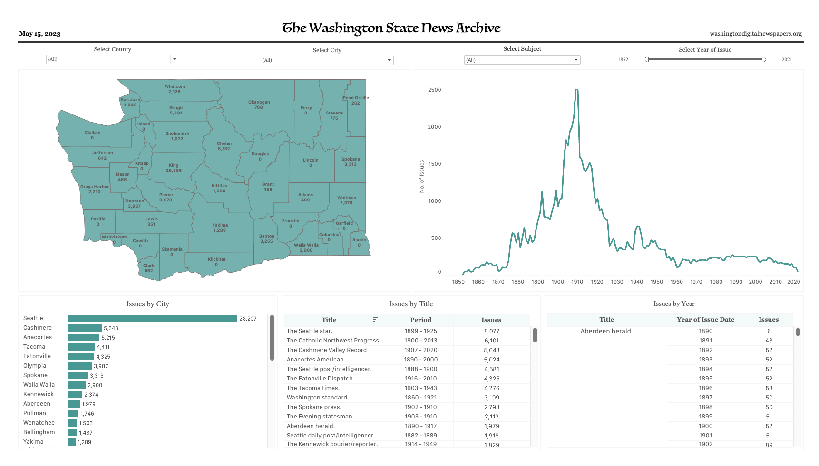
DELIVERABLES
Digitized Newspaper Data Visualization
The final deliverable is a Tableau data visualization dashboard which
Provides a dynamic and interactive approach to understanding the current data
Helps in identifying gaps in the current data
Serves as a platform to market the data as well as increase reach
Highlights
Filters gives the power to focus on key areas of interest
Insights into newspaper digitized by county, city, period
Temporal insights of digitized newspaper issues
Geographical view of newspaper issues by counties & cities - additional spatial file was brought in & joined with the csv file to create the map
SUNDAY ● JUNE 4 ● 2023
WASHINGTON STATE LIBRARY
EDITION Nº 001

Slide 9
BENEFITS
The Ultimate Platform
Bridging Gaps in Data
Widen the Reach
Interactive Insights
The project brings together all the identified data, county representation, and temporal information onto a single dashboard. This means that users can access and view all the relevant information in one place, simplifying the process of data exploration and analysis.The project also provides insights into each county's representation within the digitized issues. It allows users to visualize and analyze the data over time, offering a temporal perspective on the digitized content.
WSL has a repository of all of the digitized issues that they have on their website, but in an unclean format, which makes it difficult to navigate through, or identify where there are any missing issues. Through visualization on the dashboard, users can identify gaps or missing information within the digitized issues. This helps users recognize areas where information is incomplete and prompts further investigation.
The project enables WSL to identify all the data they have available, specifically digitized issues that can be accessed on their website. This means that the project helps in recognizing and organizing the existing digital content. The dashboard created as part of the project emphasizes ease-of-use. Its intuitive design and functionality make it an effective tool for displaying all the information in a centralized manner, achieving the goal of providing a user-friendly experience for data exploration.
The project leverages Tableau Public, a data visualization tool, to make the information easily accessible to users worldwide. By utilizing Tableau Public, the project team has succeeded in cleaning, filtering, and presenting the current information in a user-friendly manner. The dashboard allows users to filter and customize the data according to their preferences. This high level of interactivity empowers users to explore the data and extract insights based on their specific needs.
SUNDAY ● JUNE 4 ● 2023
WASHINGTON STATE LIBRARY
EDITION Nº 001

Slide 10
IMPACT & NEXT STEPS
Impact
Data Organization: The project organizes all available digitized issues for easy access for now as well as the future.
Insights and Analysis: Users gain valuable insights and can analyze trends and patterns in the data.
Missing Information Identification: The project helps identify gaps in the digitized data for further investigation.
Global Accessibility: Integration with Tableau Public allows worldwide access to the data for the long term.
User-Friendly Interface: The user-friendly dashboard enables easy exploration and filtering of the data.
Next Steps
Hosting on the Website: The final product, which includes the user-friendly dashboard and the digitized data, needs to be deployed on the WSL website.
Integration with Tableau Public: The WSL team needs to integrate the dashboard with the Tableau Public profile of WSL. This integration will allow users to access the dashboard directly from the Tableau Public page of WSL.
Continuous Maintenance and Updates: Ongoing maintenance is required to ensure the dashboard remains functional and up to date. This includes regular monitoring of data sources, addressing any technical issues or bugs, and incorporating user feedback for improvements.
SUNDAY ● JUNE 4 ● 2023
WASHINGTON STATE LIBRARY
EDITION Nº 001

Slide 11
LESSONS LEARNED
Scope Management: Defining the project scope and managing its boundaries can be challenging. It's common to have ambitious goals that may not be feasible within the project's timeframe or resources. However, it was crucial to have set boundaries before initiating a project.
Approach: Clearly defining project objectives and scope from the beginning is essential. Regularly revisiting and refining the scope as the project progresses helps in maintaining focus and managing expectations.
Data Availability and Quality: Obtaining relevant and reliable data can be a significant challenge. It may require thorough research, contacting data providers, or dealing with incomplete or messy datasets. Exploratory data analysis is a crucial step in any data centric project.
Approach: Planning ahead and allowing ample time for data acquisition and cleaning was crucial. It's important to explore available data sources and have backup plans in case of data limitations.
Time Management: Balancing the project's workload with other academic or personal commitments can be a challenge. Meeting deadlines, allocating sufficient time for each project phase, and managing unexpected delays can be demanding.
Approach: To overcome the same & ensure effective time management requires setting realistic milestones, and maintaining regular progress tracking. Breaking down the project into smaller tasks with deadlines helps in staying on track.
Communication and Collaboration: Collaborating with teammates, advisors, or stakeholders may involve challenges such as miscommunication, conflicting opinions, or difficulty in coordinating schedules.
Approach: Establishing clear communication channels, setting regular meetings, and fostering an open and respectful environment for discussion and feedback are essential. Active listening & adapting communication styles to different stakeholders facilitate effective collaboration.
Technical Challenges: Working with complex data analysis tools, and programming languages can present technical hurdles. Debugging errors, handling computational limitations, or implementing advanced techniques may require additional learning and troubleshooting.
Approach: Maintaining a learning mindset and seeking help from mentors or online communities can overcome technical challenges. Breaking down complex tasks into smaller, manageable steps also aids in tackling technical difficulties.
SUNDAY ● JUNE 4 ● 2023
WASHINGTON STATE LIBRARY
EDITION Nº 001

Slide 12
REFERENCES
[1] National Endowment for the Humanities. (n.d.). Chronicling America: Library of Congress. Chronicling America API: https://chroniclingamerica.loc.gov/about/api/
[2] Ferriter, M. (2019, May 21). Visualizing Chronicling America Data: 15 million pages of digitized historical newspapers: The Signal. The Library of Congress. https://blogs.loc.gov/thesignal/2019/05/visualizing-chronicling-america-data-15-million-pages-of-digitized-historical-newspapers/
[3] Paranick, A. (2022, July 14). New Interactive Map and Timeline added to Chronicling America: Headlines and heroes. The Library of Congress. https://blogs.loc.gov/headlinesandheroes/2022/07/new-chronicling-america-interactive-map-and-timeline/
[4] Veridian. (n.d.). Washington Digital Newspapers. https://washingtondigitalnewspapers.org/
[5] Washington State Geospatial Open Data Portal. (n.d.). https://geo.wa.gov/
SUNDAY ● JUNE 4 ● 2023
WASHINGTON STATE LIBRARY
EDITION Nº 001

